Slide 1

Introduction of Regression
Instructor: Weikang Kao, Ph.D.

Slide 2
Correlation to Regression
Recall: Correlation
With correlation our aim is to see if there is any relationship between x and y.
How about take a step further?
Can we use one variable to predict another one?

Slide 3
The Aim of Regression
In regression, the aim is to use one or more predictors to predict the outcome variable.
Simple regression vs multiple regression.
For example, as fat or sugar intake increases does weight increase?

Slide 4
Advantages of Regression
Why regression?
ANOVA, z and t-tests, and chi-square tests allow us to make comparisons between multiple groups (categorical predictor levels) means.
Limitations:
The biggest limitation is we cannot really include continuous predictors (Age, Weight, Income, Time, etc.)
ANOVA does not build a predictive model it simply tells us where differences exist but does not quantify those differences.

Slide 5
Regression Line
From correlation to regression.
First, the correlation coefficient tells us the strength of relationship between two variables.
In bivariate regression, we have a single independent variable (predictor) and a dependent variable (criterion)

Slide 6
Regression Line
The shape of the relationship being MODELED by the correlation coefficient is linear.
So, r describes the degree to which a straight line describes the values of the Y variable across the range of X values.
Regression line helps us to create the best-fitting line to predict what the values of the Y variable will be for any given value of X.

Slide 7
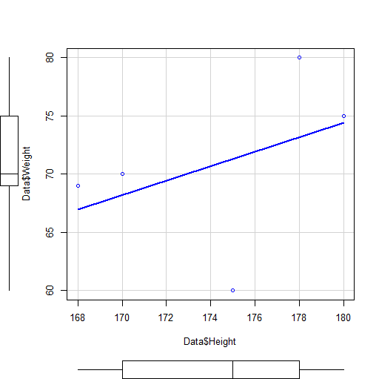
Regression Line example

Slide 8
Regression Line
In mathematic, how do we define a straight line?
Y = a + bX
In regression, the idea is the same.
Y = b0 + b1X
Intercept (b0) and gradient (b1)

Slide 9
Model of Regression
Idea of prediction: outcome = (model) + error
Like Correlation, regression can be positive or negative
Two important factors in terms of defining a straight line.
Intercept (b0) and gradient (b1)

Slide 10
Parameters of Regression
Those parameters (b0 and b1) are the regression coefficients.
Regression model:
Outcome (Y) = [b0 + b1(X1)] + error
b1 tells us what the model looks like and b0 tells us where the model is.
These weights are known as coefficients (typically Betas: 𝜷) and coefficients tell us the relative impact of a predictor (independent variable) on our dependent variable

Slide 11
Parameters of Regression
(Un)Standardized Betas
𝜷 is reserved for standardized predictors while b is used for unstandardized.
b are what we get by default when we use our variables in their raw state. They tell us the unit change in our dependent variable (in its raw units) for a unit change in our predictor variable (in its raw units).
Reference: https://www3.nd.edu/~rwilliam/stats1/x92.pdf
With 𝜷 we see the impact of a 1 SD change in the predictor on the dependent.

Slide 12
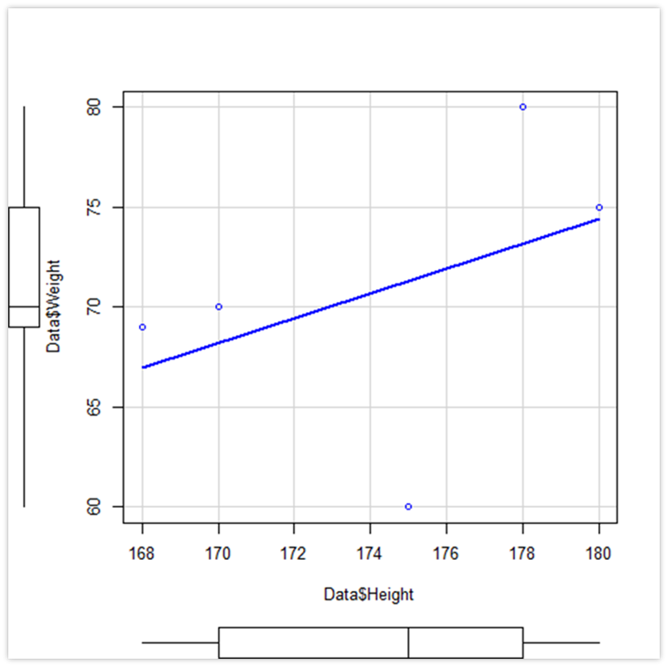
Variance in Regression

Slide 13
Variance in Regression
Recall: the correlation graph
The best fitting line is the regression model
The difference between the regression line and the mean of Y
The method of least squares
Helps to find the best fit line, we try to minimized the residual.

Slide 14
Least Squares Criterion
We try to identify the values of b0 and b1 the produce the best-fitting linear function.
So, we use the observed data to identify and create the values of b0 and b1 that minimize the distances between the observed values (Y) and the predicted values (Y-hat)
In general, we choose the regression coefficient (b1) and the regression intercept (b0) that define the regression line that minimized the sum of square residuals.
min Σ[Y-(b0 + b1X)]² = min Σ(Y- Ŷ)²

Slide 15
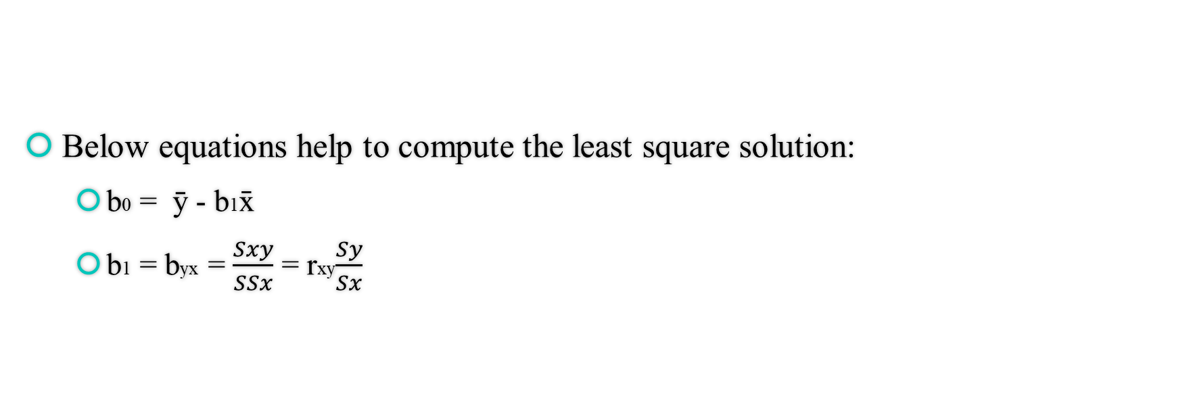
Regression Coefficients
Below equations help to compute the least square solution:
b0 = ȳ - b1x̄
b1 = byx = $\frac{Sxy}{SSx}$ = rxy$\frac{Sy}{Sx}$

Slide 16
Predicting Y From X
Predicted Score (Y-hat):
By using the best-fitting model, we can take any value of X, substitute it into the regression equation, and compute the value of Y.
Observed Score (Y):
The actual score we find in our data.
Residual Score (Error):
The difference between the predicted score and observed score, when using the same value of X.

Slide 17
Variance in Regression
How to determine whether it is a good regression model?
The best fitting model vs the basic model
What is the basic model?
The mean of y
Sum of square total: SST
The overall model is :
SST = SSR + SSE
Sum of square Regression (Model): SSR
Sum of square residual (error): SSE

Slide 18
Variance in Regression
SST = SSR + SSE
(Observed Y – Ymean) = (Predicted Y –Ymean) + (Observed Y – Predicted Y)
Variation in Y = Explained by X + Unexplained by X
SSTotal = SSRegression + SSError
What’s the importance of regression?
Without regression, what’s the best fitting model?

Slide 19

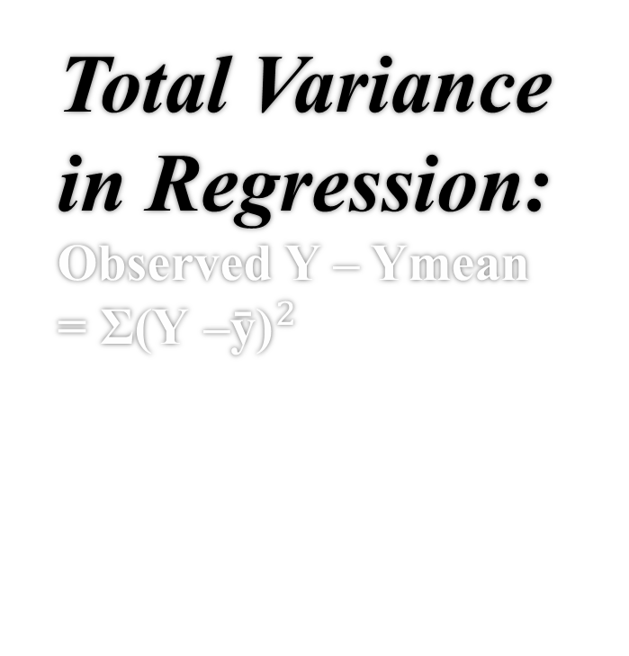
Total Variance in Regression: Observed Y – Ymean = ${\text{Σ}\text{(}\text{Y} \text{–}\text{ȳ}\text{)}}^{2}$

Slide 20
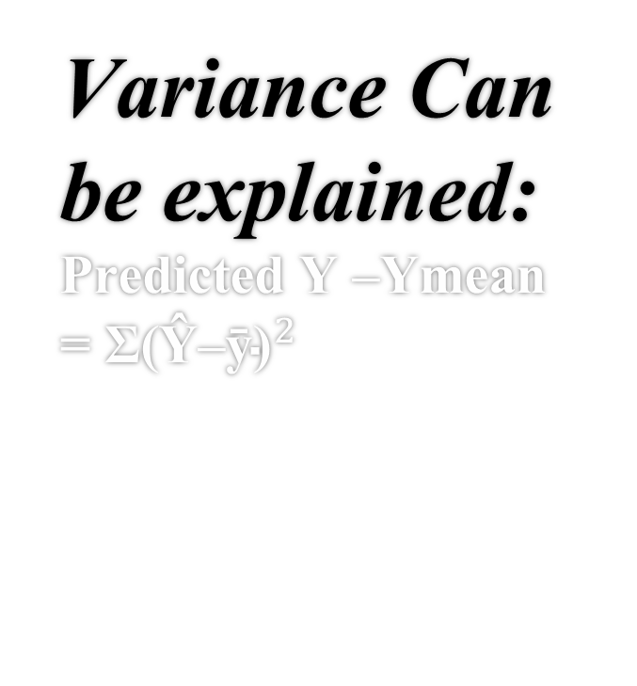
Variance Can be explained: Predicted Y –Ymean = ${\text{Σ}\text{(Ŷ–ȳ)}}^{2}$

Slide 21

Variance Can Not Be Explained: Observed Y – PredictedY = ${\text{Σ}\text{(}\text{Y} \text{–}\text{Ŷ}\text{)}}^{2}$

Slide 22
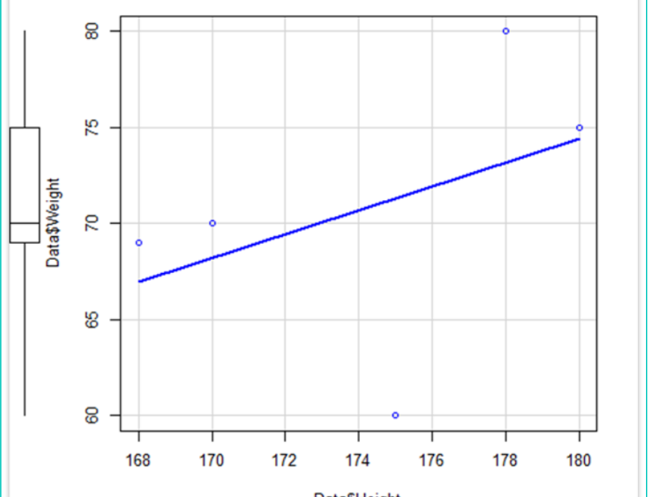

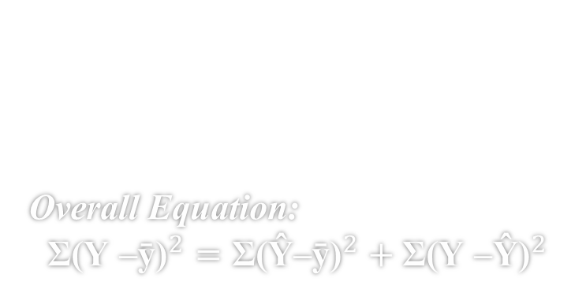



Overall Equation: $${\text{Σ}\text{(}\text{Y} \text{–}\text{ȳ)}}^{2}={\text{Σ}\text{(Ŷ}\text{–}\text{ȳ)}}^{2}+{\text{Σ}\text{(}\text{Y} \text{–}\text{Ŷ)}}^{2}$$
$$\text{Y} \text{–}\text{Ŷ}$$
$$\text{Y} \text{–}\text{ȳ}$$
$$\text{Ŷ}\text{–}\text{ȳ}$$
$$\text{Ŷ} =\text{b}\text{0} \text{+ }\text{b}\text{1}\text{X}$$

Slide 23
Things to Check
The regression line ALWAYS passes through the point (X, Y)
The mean of the predicted scores is ALWAYS equal to the mean of the observed Y score.

Slide 24

Regression: Tests

Slide 25
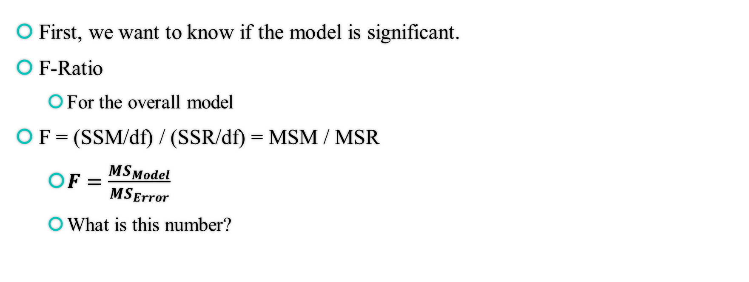
Test the Overall Regression Model
First, we want to know if the model is significant.
F-Ratio
For the overall model
F = (SSM/df) / (SSR/df) = MSM / MSR
$F=\frac{{MS}_{Model}}{{MS}_{Error}}$
What is this number?

Slide 26
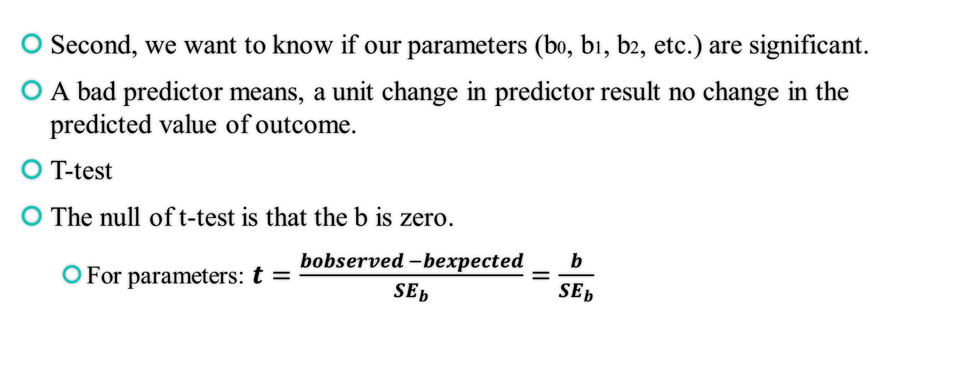
Test the Individual Parameter
Second, we want to know if our parameters (b0, b1, b2, etc.) are significant.
A bad predictor means, a unit change in predictor result no change in the predicted value of outcome.
T-test
The null of t-test is that the b is zero.
For parameters: $t=\frac{bobserved −bexpected}{{SE}_{b}}=\frac{b}{{SE}_{b}}$

Slide 27
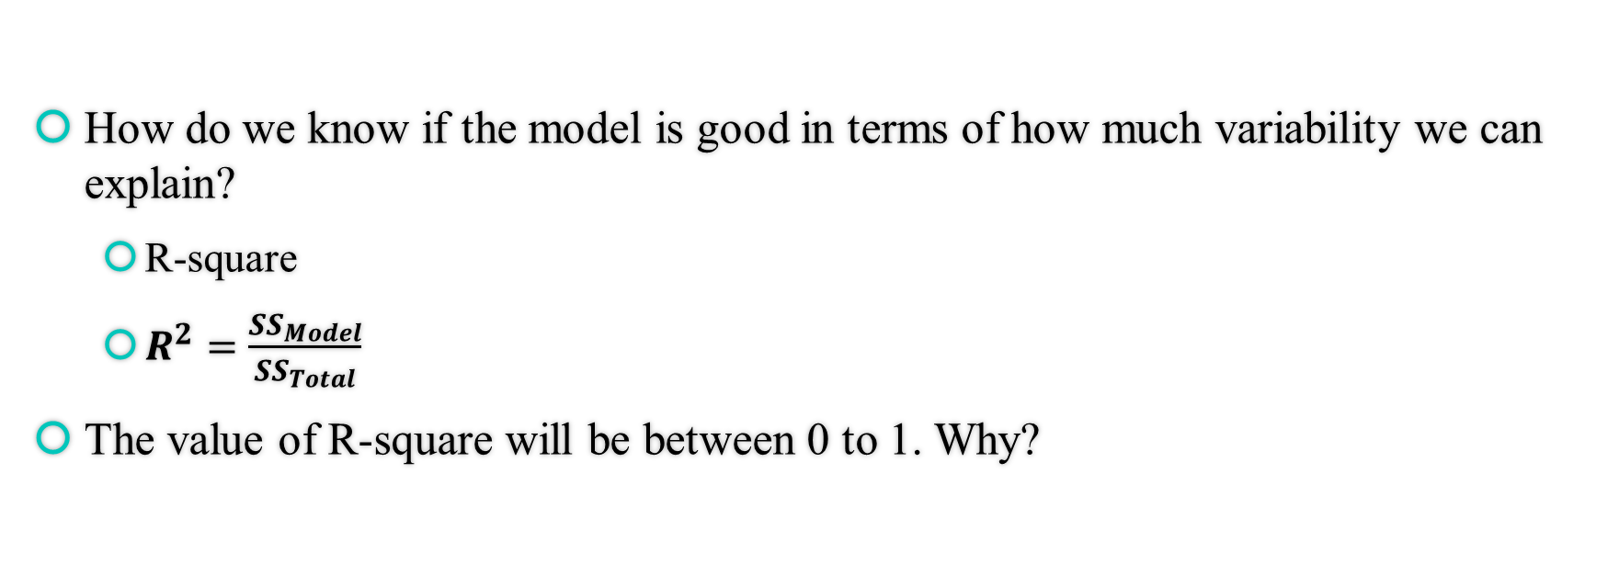
R-square in Regression
How do we know if the model is good in terms of how much variability we can explain?
R-square
$R^{2}=\frac{{SS}_{Model}}{{SS}_{Total}}$
The value of R-square will be between 0 to 1. Why?

Slide 28
Regression: Hypothesis
The null hypothesis:
There is no relationship between the X variables and the Y variable
Alternative hypothesis:
There is a significant relationship between the X variables and the Y variable

Slide 29
Regression: Assumptions
1. The type of variable
All predictor variables must be quantitative or categorical
The outcome variable be quantitative and continuous.
2. Non- zero variance
The predictors should have some variations.
3. No perfect multicollinearity
There should be no perfect linear relationship between two or more predictors.
4. Predictors are not correlated with extraneous variables
Influence the reliability of our model, think of the third-party issue.

Slide 30
Regression: Assumptions
5. Heteroscedasticity
Equal residual variances along regression line
6. Independent errors
Errors are not correlated with others
7. Normally distributed errors
The residuals in the model with a mean of zero.
8. Independence
All the values of the outcome (pairs) variable are independent
9. Linearity
The mean value of the outcome variable for each increment of the predictor lie along a straight line

Slide 31
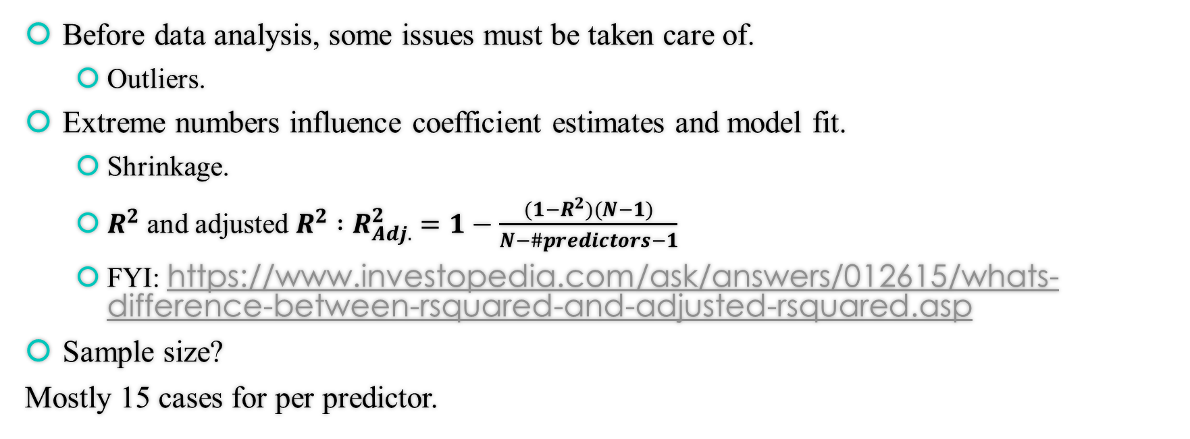
Regression
Before data analysis, some issues must be taken care of.
Outliers.
Extreme numbers influence coefficient estimates and model fit.
Shrinkage.
$R^{2}$ and adjusted $R^{2}$ $:R_{Adj.}^{2}=1−\frac{(1−R^{2})(N−1)}{N−\#predictors−1}$
FYI: https://www.investopedia.com/ask/answers/012615/whats-difference-between-rsquared-and-adjusted-rsquared.asp
Sample size?
Mostly 15 cases for per predictor.

Slide 32

Pick the Right Tests: Scenario Practice

Slide 33
Scenario 1
A current study is interested in determine the effect of a new drug upon the number of pictures recalled. Prior research had established a strong correlation between painting skills and pictures recall. Therefore, individual differences in painting skills were controlled to produce a more sensitive test of the treatment effect.
What test should we use?
What are the IV and DV?

Slide 34
Scenario 2
Suppose we have data on blood pressure levels for males and females and we wish to see if one sex has higher/lower blood pressure than the other.
What test should we use?
What are the IV and DV?

Slide 35
Scenario 3
A current study is interested in whether individuals’ weight change can be predicted by how many soda they drink per day.
What test should we use?
What are the IV and DV?

Slide 36
Scenario 4
In a current data we collect, we notice that there is a strong correlation between consumers’ attitudes toward our brand and how many reward bonuses they receive every year. We would like to do some further analysis to see if we can use reward bonus receive to predict consumers’ attitudes.
What test should we use?
What are the IV and DV?

Slide 37

Regression: Application

Slide 38
Regression: Application
Use the “(simplerelationships.xlsx) “ data.
Income – how much a person earns per year
Percent Income Saved – what percent of income carried over to next year and can be negative if more money was spent than came in.
Score on a savings motivation metric – an ordinal scale.

Slide 39
Regression: Assumptions
Check assumptions:
The type of variable:
Is it good?
Non- zero variance
Use graph or look at the variance.
plot(density(data$Income))
plot(density(data$PI))
plot(density(data$MS))

Slide 40
Regression: Assumptions
Multicollinearity:
We have only one predictor here.
Predictors are not correlated with extraneous variable.
Heteroscedasticity:
The variance around the regression line should be equal across values of x.
scatterplot(data$Income, data$PI)

Slide 41
Regression: Assumptions
Independent errors:
We have no issue because we assume a random sample with no repeated measurement.
Normally distributed error:
qqnorm(data$PI)
sshapiro.test(model$residuals)
Independence:
Linearity:
scatterplot(data$Income, data$PI)

Slide 42
Regression: Application
Build the regression model:
model <- lm(PI ~ Income, data = data)
#PI is the outcome variable and Income is the predictor variable
F (1, 97) = 18.37, p < .001, R² = .16.
 | Estimate | Std. error | T-value | P-value
Intercept | -8.378e-03 | 2.570e-03 | -3.26 | 0.00154
Income | 1.097e-07 | 2.560e-08 | 4.29 | < .001

Slide 43
Regression Model
Based on the result, now we are able to conduct the regression model.
The expected regression model is: Y = b0 + b1X
We can replace the values of intercept (b0) and slope (b1) with our own values.
Our model is:
Y = (-0.0083) + (.0000001097 )X

Slide 44
Regression: Summary Write Up
A simple regression model was conducted to predict participants’ money-saving motivation, based on their annul income. All the regression assumptions were met, and no further adjustment made. A significant regression equation was found (F (1, 97) = 18.37, p < .001), with an R² of .16. Both the intercept (p = .002) and predictor (p < .001) were statistically significant. The result suggested that, income predicts and shows that for each dollar increase in income there is a .0000001097 percent increase in savings.

Slide 45

In Class Practice

Slide 46
In Class Practice
Example: Can we use either height or weight to predict heart rate?
Make sure you test the assumption and do a summary write up.
Height: 175, 170, 180, 178, 168, 181, 190, 185, 177, 162
Weight: 60, 70, 75, 80, 69, 78, 82, 84, 72, 53
Heart Rate: 60, 70, 75, 73, 71, 73, 76, 80, 68, 64

Slide 47

Non-Linear Trends

Slide 48
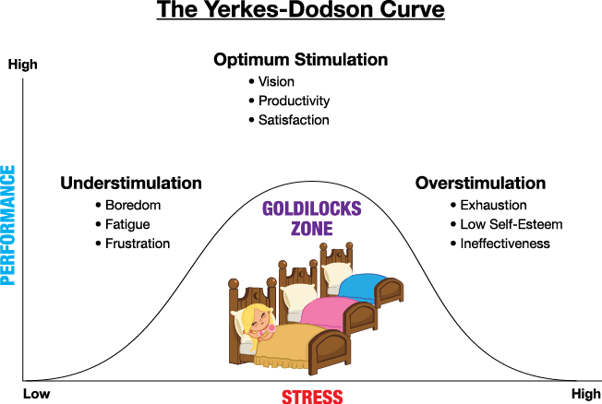
Non-Linear Trends
Many relationships are not best captured as straight lines.
For example, the effect of stress on performance is known to follow a quadratic trend (Yerkes-Dodson curve).
What should we do?

Slide 49
Non-Linear Trends
Always plot our data.
Using the scatterplot function in R two lines will be drawn (car library needed):
The red lines (by default) is a “smoothed” fit (only useful for thinking about trend)
The green line (by default) plots the best fitting linear trend (regression line).

Slide 50
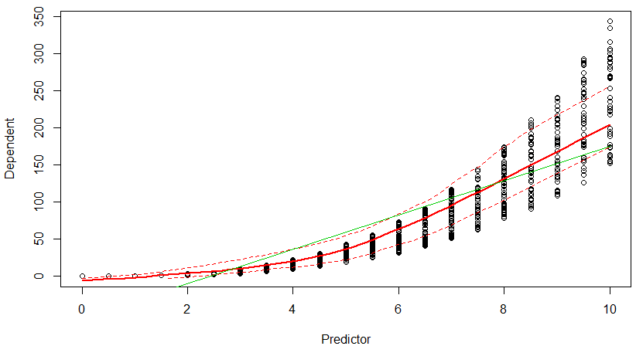
Non-Linear Trends
It looks like we have a non-linear trend – higher values of the predictor are related with a quicker increase (steeper slope) in our dependent than lower values.
We also see the linear model is going to do a poor job fitting the data.

Slide 51
Capturing Non-Linear Trends
In many cases we can use linear regression to capture non-linear trends.
However, you will want to pay close attention to your residuals as frequently you will get good model fit, but that fit may be deceptive (e.g., predicting before and after a curve poorly but other points well).
In the example graph on the preceding slide it appears the predicted slope gets steeper as the predictor increases (linearly) – a quadratic trend.
Such trends can be captured by adding a x^2 of the predictor to the model.
If we had data that had two visible shifts, we would then consider adding higher order functions (e.g., x^3).

Slide 52
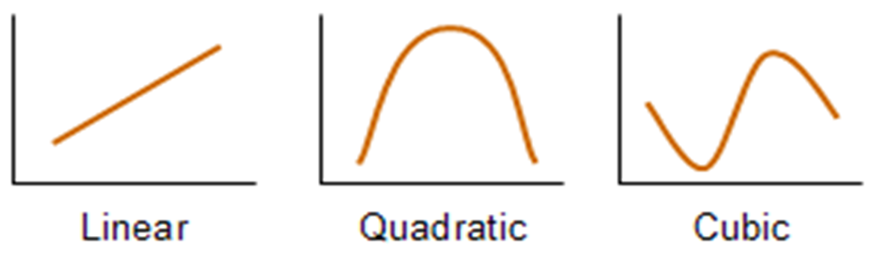
Capturing Non-Linear Trends
It should be noted that a heuristic for determining your polynomial effect(s) is to count the shifts (going from up to down, up to flat, and so on).

Slide 53

Conducting a Non-Linear Regression Model
Quadratic:
$\text{Ŷ}$ = b0 + b1X1 + b2${\text{X}\text{1}}^{2}$
Cubic:
$\text{Ŷ}$ = b0 + b1X1 + b2${\text{X}\text{1}}^{2}$ + b2${\text{X}\text{1}}^{3}$

Slide 54
Lower Order Trends
When we include higher order trends it is important, we do not remove their lower order components.
For example, if we wanted to add a quadratic trend to the model, we need to keep the linear trend in as well even if its not significant.
What does that mean?
To include a cubic trend we must include the quadratic and linear trends as well.
The reason for this is that if we do not include the lower order trends the higher order trends will capture in part these effects which would bias our estimates.
A potential issue that will pop up as you include trends beyond linear is multicollinearity (predictors sharing some of the same predictive variance – Age and Income).

Slide 55
Non-Linear Trends: Example
We try to simulate a non-linear dataset (Lionel, 2016)
set.seed(20191007)
x<-seq(0,50,1)
y<-((runif(1,10,20)*x)/(runif(1,0,10)+x))+rnorm(51,0,1)
Plot our data:
plot(x,y)

Slide 56
Non-Linear Trends: Example
From this graph set approximate starting values
a_start<-8
b_start<-2*log(2)/a_start
Build the model:
model<-nls(y~a*exp(-b*x),start=list(a=a_start,b=b_start))
Find the best fitting line:
lines(x,predict(model),lty=2,col="red",lwd=3)

Slide 57
In Class Practice II
When should we use regression instead of ANOVA?
Please explain the relationship between SStotal, SSregression and SSerror.
Please use the following data to build a regression model and write a summary. IV is sugar and DV is calories.
Sugar: 5, 8, 9, 10, 15, 18, 14, 17, 20, 22, 24, 26, 30 ,30, 32
Calories: 20, 30, 60, 70, 100, 95, 70, 83, 103, 112, 130, 80, 95, 130, 112

